Slide 1
MERGE Greenwich
MATSim User Group – Atlanta 2018
Haris Ballis
Transport Modeller

Slide 2
Project Summary
Aim and consortium members
The Merge Greenwich is a Government sponsored (Innovate UK) research project which brought together six organisations with significant and complementary expertise.
The aim was to develop a commercial blueprint of how it’s possible to bring Autonomous Vehicle Ride-Sharing (AVRS) services onto the roads (of Greenwich).
The MERGE Greenwich Project
Notes:
AVRS = think like uber pool on autonomous vehicles
Digital Greenwich is the Royal Borough of Greenwich’s in-house team setup to develop and implement its smart city strategy

Slide 3
Introduction
Before we start
The term AVRS stands for Autonomous Vehicle Ride-Sharing
Notes:
Everyone familiar with Ride sharing?
The modelling team had no prior experience with MATSim before this project so some decisions may be unfortunate. Your feedback is more than welcome

Slide 4
Model Description
Overview
Main attributes
Trip-end model based on the UK National Trip End Model (NTEM)
Internal Model Area: Greenwich (33 zones)
Transport Modes
Car
Car passengers
*Rail trips (simulated as egress/access trips to train stations using the abovementioned modes)
Bus
Model Area: London (65 zones)
Autonomous Vehicle Ride-Sharing (AVRS) service tiers (2 tiers)
Network
Road network from OpenStreetMaps with higher resolution in Greenwich Area
(14,063 nodes / 26,312 links)
Bus network and schedule from Transport for London (Tfl) GTFS data using the pt2matsim module
Base Year: 2025
Notes:
Special thanks to pt2matsim team (Flavio Poletti, Sebastian Hörl) – mention bug with mph and possibility to include routing from OSM relations

Slide 5
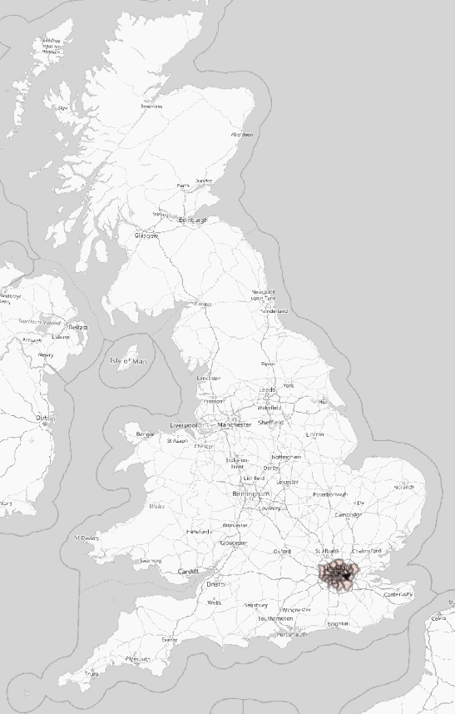
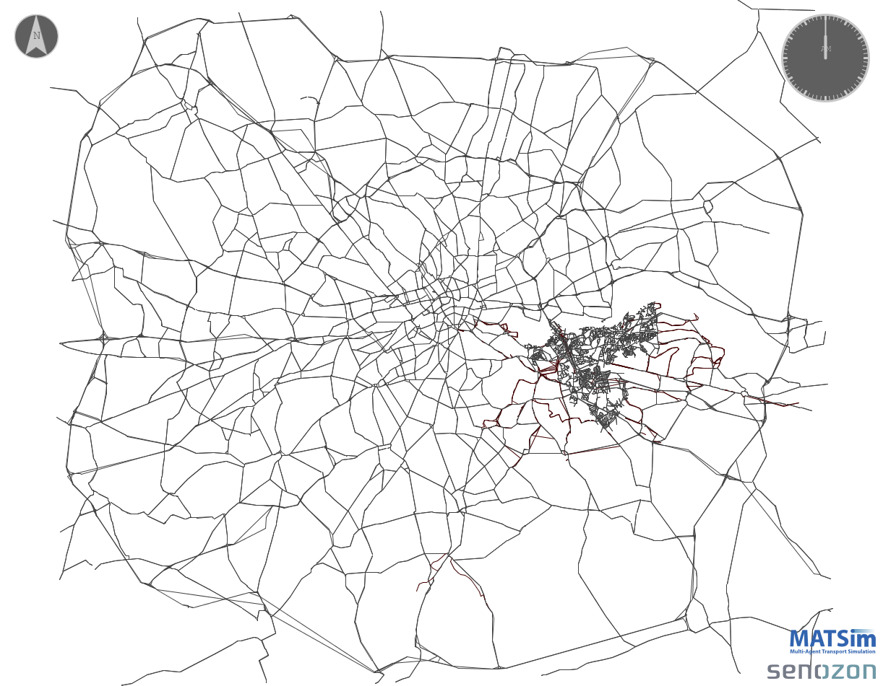
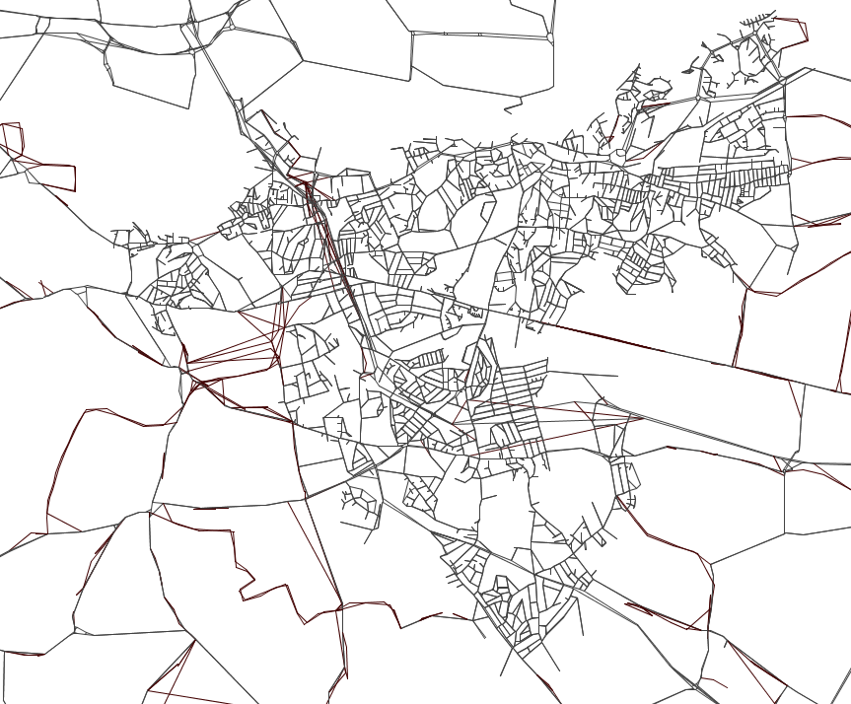
Model Description
Zoning System and Network representation
14,063 nodes / 26,312 links
Map of the UK
65 zones
33 internal / 32 external

Slide 6
Model Description
“Population Synthesis"
Trip based model but multiple attributes assigned to each individual trip.
The terms trip/person will be used interchangeably from now on
National Trip End Model (NTEM)
Purpose
National Travel Survey (NTS)
Exact departure time
Time period of departure
Initial Mode
Age
Gender
Income
Project specific survey
Attitude towards AVRS (likelihood to use the service)
Used to control the demographic characteristics of the HomeBased trips
Other sources
Value of Time
Parking costs
UK Census
Assistance requirements
OD Matrix

Slide 7
Model Preparation
Reducing population’s size
Total Initial Demand
Filter crossing OD pairs
Filter the internal modelled area movements
for all modes but car
13 Million trips
1 Million trips
Final demand for simulation
0.64 Million trips
95% reduction of initial population

Slide 8
Model Preparation
Filtering crossing OD pairs

Slide 9
Model description
Population attributes
Trip/Person (640,000 in total)
Age
Gender
Female
Male
Young
Middle Aged
Older
Income
Lower
Mid
Car
AVRS
(by tier)
Commuting (HBW)
Value of Time
Other
(HBO, NHB)
Purpose
Attitude to AVRS
Bus
Employers Business (EB)
Parking cost
Assistance needed
Other
Higher
Transport Mode
Car Passenger
Internal / External

Slide 10
Model description
Available Transport Modes
Standard Modes
AVRS Modes (Tiers)
Car
Car passenger
Bus
Standard (4 seats)
Minibus (8 seats)
Transport Mode Costs
Relevant work package
Relevant literature review¹
Based on consortium members recommendations
1. e.g. Bösch, P. M., Becker, F., Becker, H., & Axhausen, K. W. (2017)

Slide 11
Mode Choice
Personalisation of scoring components
Marginal Utility of Performing
marginalUtilityOfPerforming linked with Value of Time
Mode availability by person. The current implementation assigns a penalty score each time a non-allowed mode switch was taking place
Mode Availability
More sophisticated options are being evaluated
Personalised utilityOfMoney based on income*
Utility of Money
Other
Parking fares depending on destination location and trip purpose
Bus fares depending on age (free for older people)
* e.g. Layard, Nickell, & Mayraz, 2008
Notes:
Remind that we talk about a trip based model

Slide 12
Mode Choice
Parking Fares
Trips ending inside the highlighted areas were charged with an additional parking cost based on the trip purpose
Trip Purpose | Parking Fare
Commuting | £10
Other | £2.5
Business | £5

Slide 13
Simulation
Simulating AVRS fleet
For MERGE the AVs were not simulated using the DVRP module. Instead an external optimiser developed by Immense Ltd was used. The interaction between the 2 models is presented below.
* AVRS is immediately available and no detour time is included at this stage

Slide 14
Simulation
Updating Scores
At the end of each iteration a module responsible for updating scores is invoked
Updating Score
Public transport fares
Parking costs
AVRS experienced wait and detour times. Adjustment for lost opportunity time
Penalising non-allowed mode switches
Suggestions on alternative or more robust implementation are welcome!

Slide 15
Simulation
Consolidating plans
In order to retain the diversity between the available plans a mechanism to allow for only one plan per mode was introduced. The mechanism kept only the best plan executed for each mode.
Many agents seemed to fill their memory with very similar plans of the same mode thus excluding the newly introduced modes as viable alternatives during the last iterations (innovation=false)
Person
Plan3
Plan1
Mode: car
Score: 100.0
Plan2
Mode: car
Score: 99.99
Mode: car
Score: 99.98

Slide 16
Simulation
Scenarios Definition
Simulations under three different scenarios were executed
Scenario 1 - Accessibility
Low cost flexible, bus-like service
Lower level of service
Scenario 2 - Convenience
Medium priced taxi like service
AVRS Tiers: Standard
Scenario 3 - Balanced
Combination of 1&2
AVRS Tiers: Minibus and Standard
AVRS Tiers: Minibus
High level of service
Level of service depending on the tier

Slide 17
Results
Summary
The agent-based nature of MATSim enables answering complex and very specific questions
 | Scenario 1 | Scenario 2 | Scenario 3
Car to AVRS shift (%) | 15% | 6% | 8%
Bus to AVRS shift (%) | 34% | 8% | 19%
Average travel time by bus to the metro station | 23.2 mins | 22.6 mins | 22.2 mins
Average travel time by AVRS to the metro station | 13.3 mins | 12.9 mins | 17.5 mins
Total AVRS fleet size | 706 | 332 | 458
Trips served per day | 31,536 | 9,264 | 17,512
Mean waiting time | 4:21 (Minibus) | 2:10 (Standard) | 5:15 (Minibus) 2:24 (Standard)
Mean detour time | 4:46 (Minibus) | 3:14 (Standard) | 5:41 (Minibus) 2:59 (Standard)
Vehicle occupancy (average number of people in the vehicle at peak times) | 2.5 (Peak, Minibus) | 2.0 (Peak, Standard) | 2.5 (Peak, Minibus) 1.5 (Peak, Standard)

Slide 18
Results
Mode Shift

Slide 19
Results
Effect of parking cost on mode shift

Slide 20
Results
Accessibility

Slide 21
Results
AVRS Performance evaluation

Slide 22
Conclusions
Autonomous Vehicle Ride-Sharing (AVRS)
MATSim
Seems to have great potential and can play a key role in the way people will move in the (near) future
Could supplement or even (partly) substitute mass public transport
Proved a reliable tool throughout the project
Impressed the consortium with the level of detail of the outputs
Cooperated well with external tool

Slide 23
Thank you very much for your attention
Any Questions?
For more information visit the project’s webiste

