Slide 1





An Introduction to BEAM: a framework for Behavior, Energy, Autonomy, and Mobility
Presenter: Colin Sheppard,
Development Team: Rashid Waraich, Sid Feygin, Andrew Campbell,
Michael Zilske, Conveyal, 7 Summits LLC
Advisory Team: Anand Gopal, Tom Wenzel
MATSim User Meeting
June 23, 2018

Slide 2

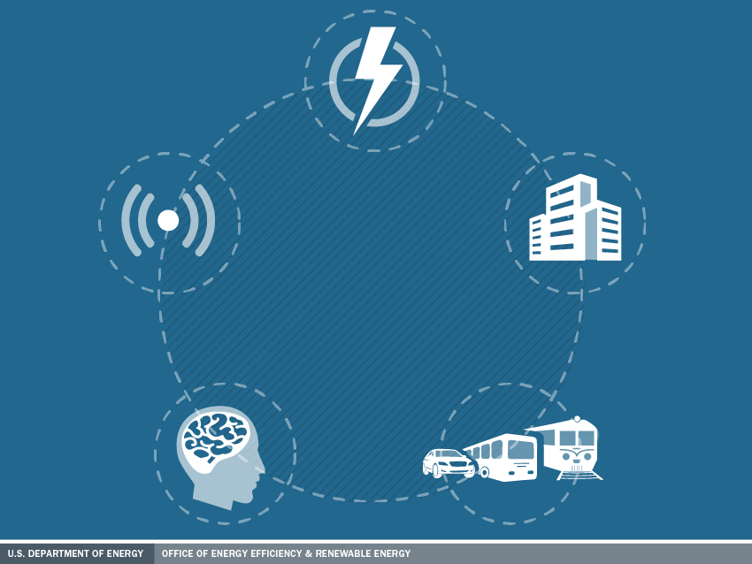


Advanced
Fueling Infrastructure
ENERGY EFFICIENT MOBILITY SYSTEMS PROGRAM INVESTIGATES
MOBILITY ENERGY PRODUCTIVITY
Connected & Automated Vehicles
Urban Science
CONSORTIUM
SMART MOBILITY LAB
Advanced R&D Projects
Living Labs
THROUGH FIVE EEMS
ACTIVITY AREAS
Smart Mobility Lab Consortium
Core Evaluation & Simulation Tools
Mobility Decision Science
Multi-Modal Transport
HPC4Mobility &
Big Transportation Data Analytics
Notes:
With DOE, the National Labs are undertaking new research to better understand the potentially dramatic energy impacts of new technologies and business models like connected and automated vehicles and shared mobility.
DOE’s Energy Efficient Mobility Systems (or EEMS) was created to investigate opportunities to increase mobility energy productivity.
Within EEMS, activities are split into five focus areas, one of which is the SMART Mobility Lab Consortium

Slide 3
Advanced
Fueling Infrastructure
Connected & Automated Vehicles
Urban Science
CONSORTIUM
SMART MOBILITY LAB
7 labs, 30+ projects, 65 researchers, $34M* over 3 years.
Mobility Decision Science
Multi-Modal Transport
*Based on anticipated funding
Notes:
the SMART Mobility Lab Consortium consists of five focused pillars of research. My project today is a task under the ___ Pillar which aims to ___ [Presenter Note: Choose appropriate bullet below]
Connected and Automated Vehicles (or CAVs): Understanding the energy, technology, and usage implications of connected and autonomous technologies and identifying efficient CAV solutions.
Mobility Decision Science: Identifying the transportation energy impacts of potential travel and lifestyle decisions and understanding the human role in the mobility system.
Multi-Modal Transport: Reducing modality interface barriers for passenger and freight movement and understanding the interrelationships between various modes.
Urban Science: Evaluating the intersection of transportation networks and the built environment in terms of energy opportunities.
Advanced Fueling Infrastructure: Understanding the costs, benefits, and requirements for fueling/ charging infrastructure to support energy efficient future mobility systems.

Slide 4
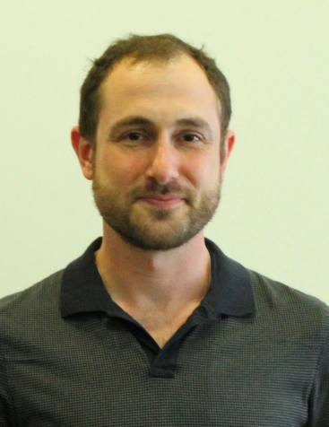


Key BEAM Contributors
Colin Sheppard
Rashid Waraich
Sid Feygin
Michael Zilske
Andrew Campbell

Slide 5

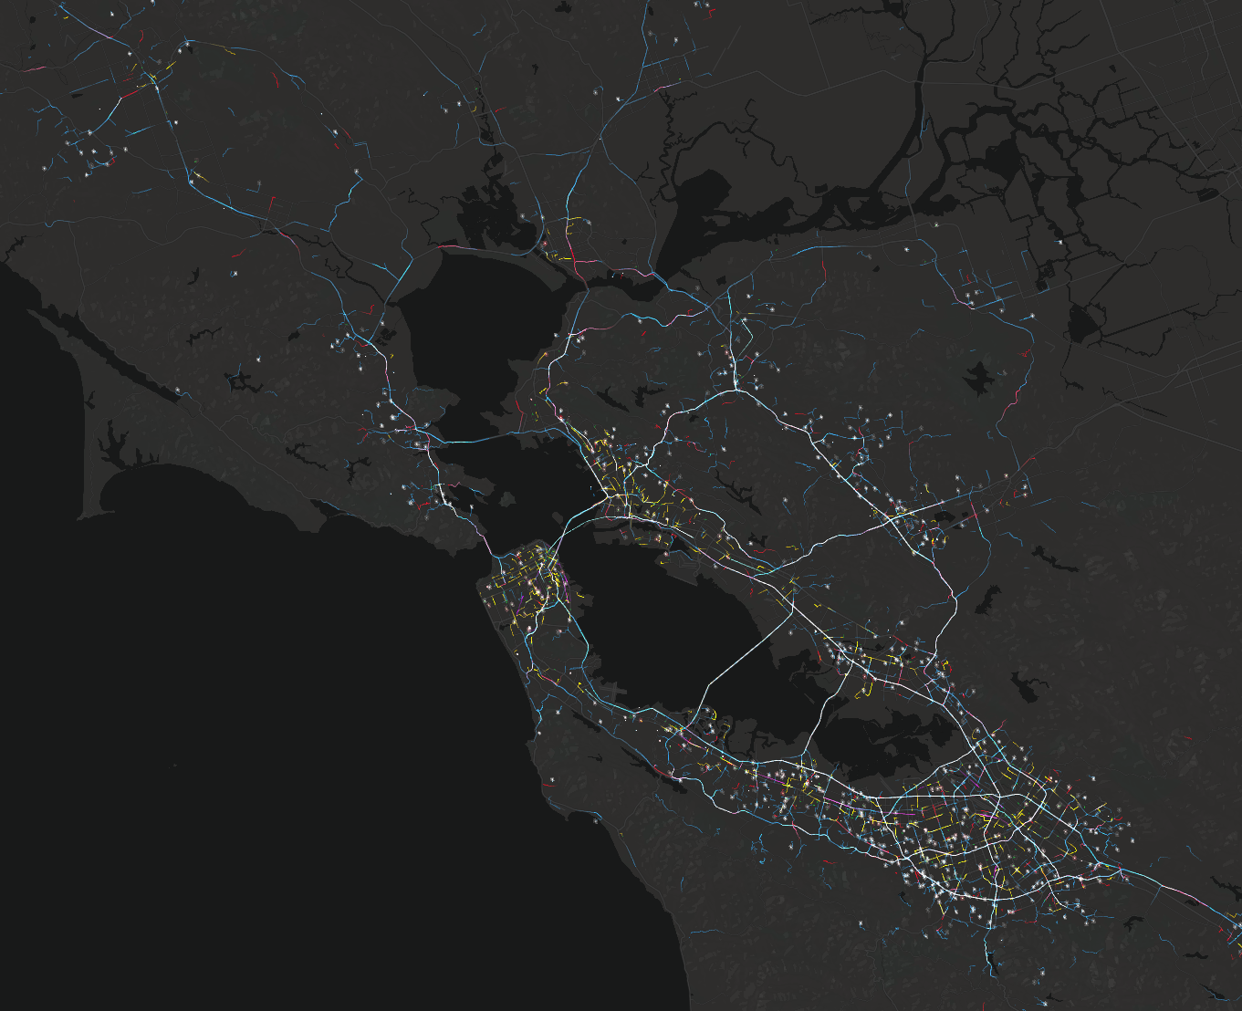
BEAM Objective
Challenges
Transportation system becoming more dynamic
Scalable dynamic simulation
Goal
Estimate the energy and accessibility implications of modal shift among conventional transit and emerging travel systems (emphasis on transit vs. TNCs and electrification)
Approach
Develop mobility simulation engine designed for parallel execution and demand responsive transportation

Slide 6
BEAM is for Resource Markets
Resource Markets:
  Road Capacity
  Vehicle Capacity
  TNC Availability
  Parking/Refueling Access
Cost & Time
Supply:
  Driving
  Transit (any GTFS)
  Walk
  TNC (automated, manual)
  Parking
  Refueling Infrastructure
  Biking
Demand (governed by behaviors):
  Mode Choice
    Price & Time Sensitive
  Route Choice
    Multimodal
  Rerouting
  Park Choice
  Refuel Choice

Slide 7
What is BEAM?
Primarily a new mobsim engine for MATSim
Introduces new approach to parallel execution to the mobsim
Written in Scala
Maintains as much compatibility with MATSim as possible
  All standard MATSim events are thrown
  Runs from MATSim inputs and configuration data along with some new inputs

Slide 8
What does BEAM solve?
Parallel execution of within-day dynamics including resource competition
Fully multimodal from the ground up
Decoupling traffic sim from other within-day dynamics

Slide 9
BEAM Architecture
BEAM Mobility Sim

Slide 10
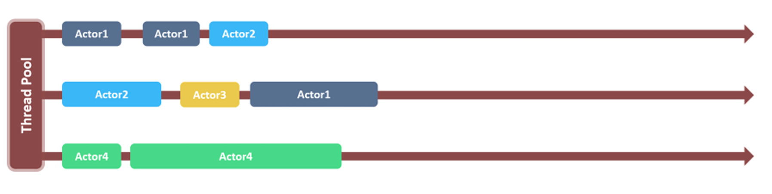
BEAM is designed for High Performance
Actor Model of Computation
Parallel Discrete Event Scheduler
Akka actor system manages multi-plexing and cluster deployment
With 1 master, 2 worker nodes we have achieved ~15 min per iteration for 410k agents and full network detail
Smart Bay: 500k agents, no local roads, ~30 min
Smart Bay: 100k trips, with local roads, ~60 min

Slide 11
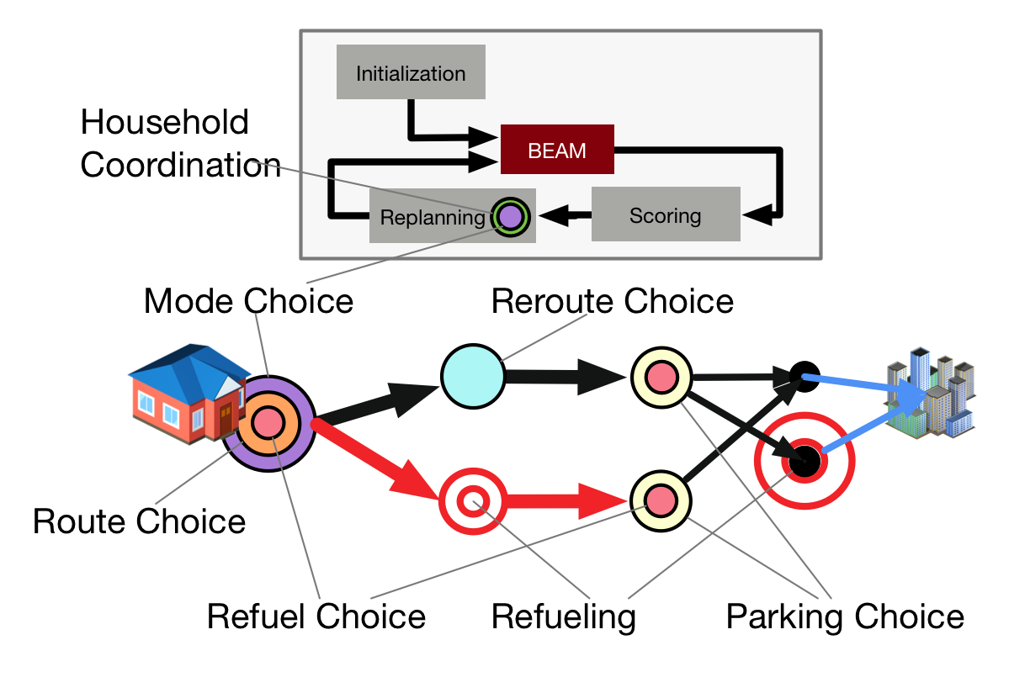
Behavioral Modeling in BEAM

Slide 12
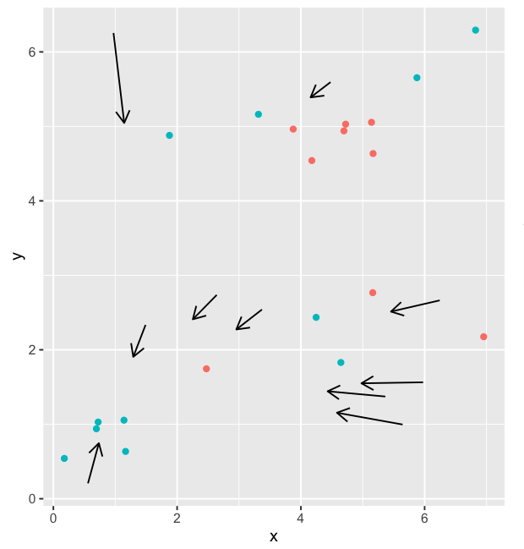
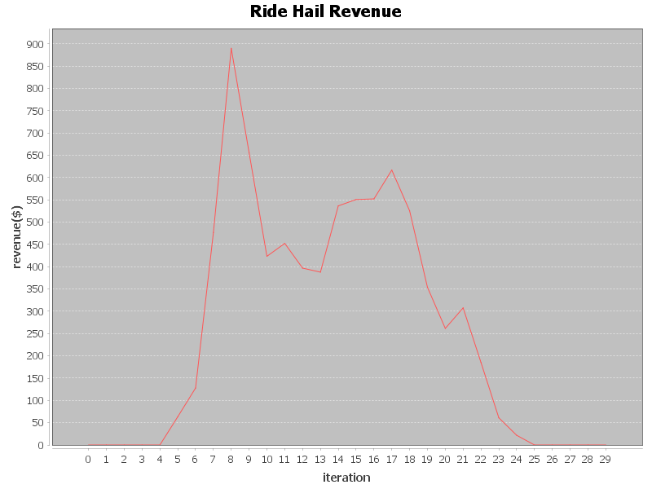
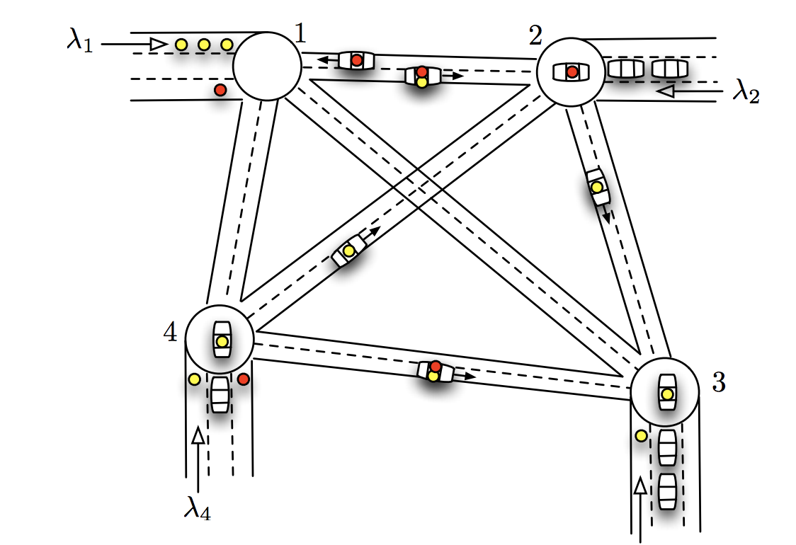
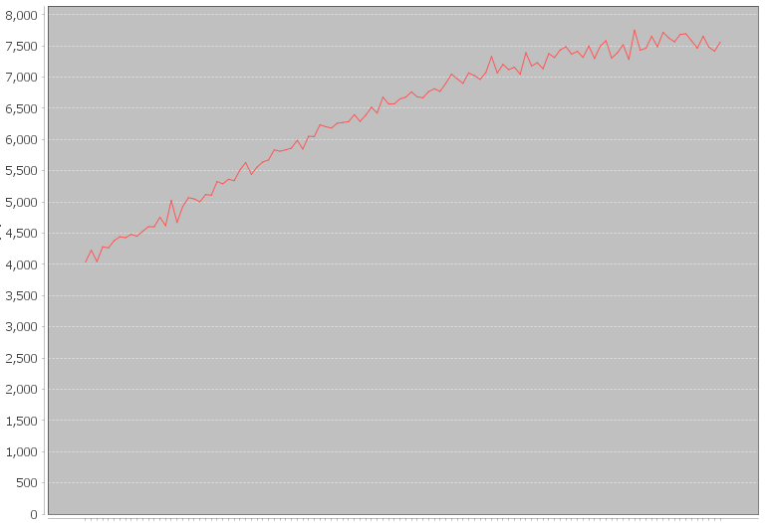
Surge Pricing, Rebalancing, Control
Surge price impacts supply and demand of TNCs
Ride hail management API: others can deploy fleet optimization schemes for customer matching, rebalancing, and recharging
Revenues
Hour of Day
Rebalancing Algorithm
Fraction of idle drivers rebalance every t minutes
Selected drivers randomly dispatched to nearby TAZs based on weighted combination of demand, wait times and idle time from previous iterations
Revenues
Iteration

Slide 13
Conceptual Vision for Model Integration

Slide 14
Specific Vision for Model Integration

Slide 15
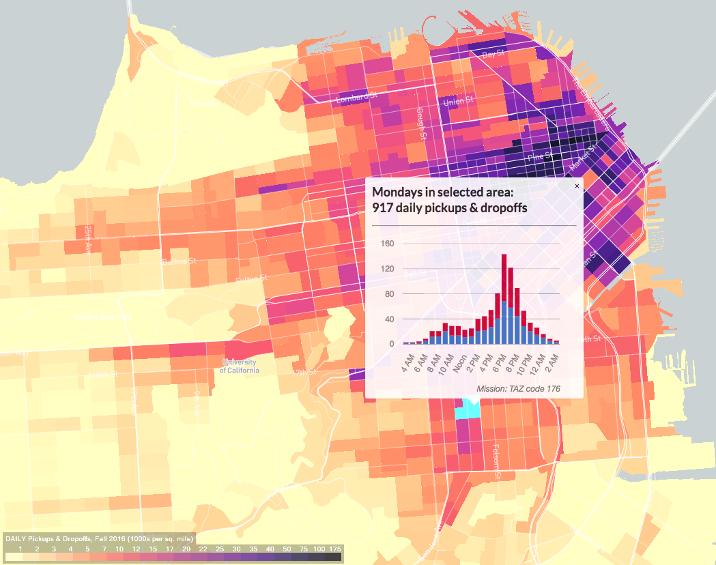
Calibration
Bayesian Optimization API
Modeled vs Observed
Traffic Counts
Behavioral
Parameters
Modal Splits
Set A
Set B
BEAM
Loss
Transit Ridership
Set C
TNC Use

Slide 16
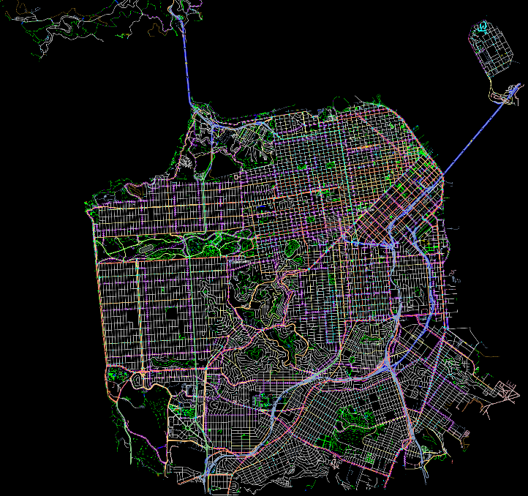
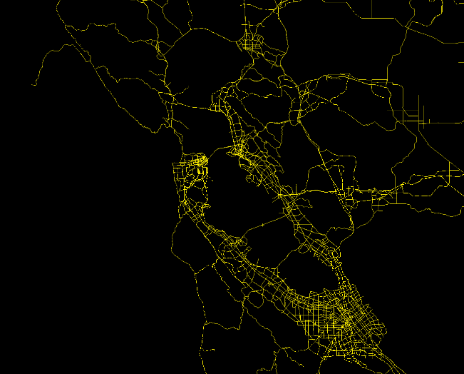
Scenarios used for Illustrative Results
San Francisco Only Scenario
  3% Sample (25k person, 26k vehicles, 500 TNC fleet, Muni + BART)
Full Bay Area Scenario
  5% Sample (~400k persons, 340k cars)
  Full Transit (27 agencies, 828 routes)
  TNC Fleet (20,000 - also referred to as Ride Hailing)

Slide 17
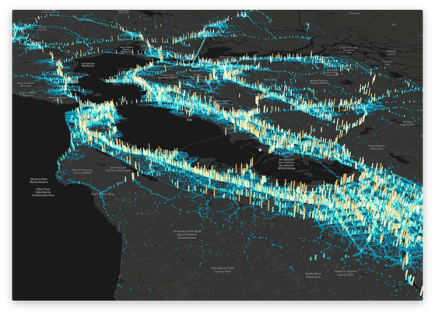
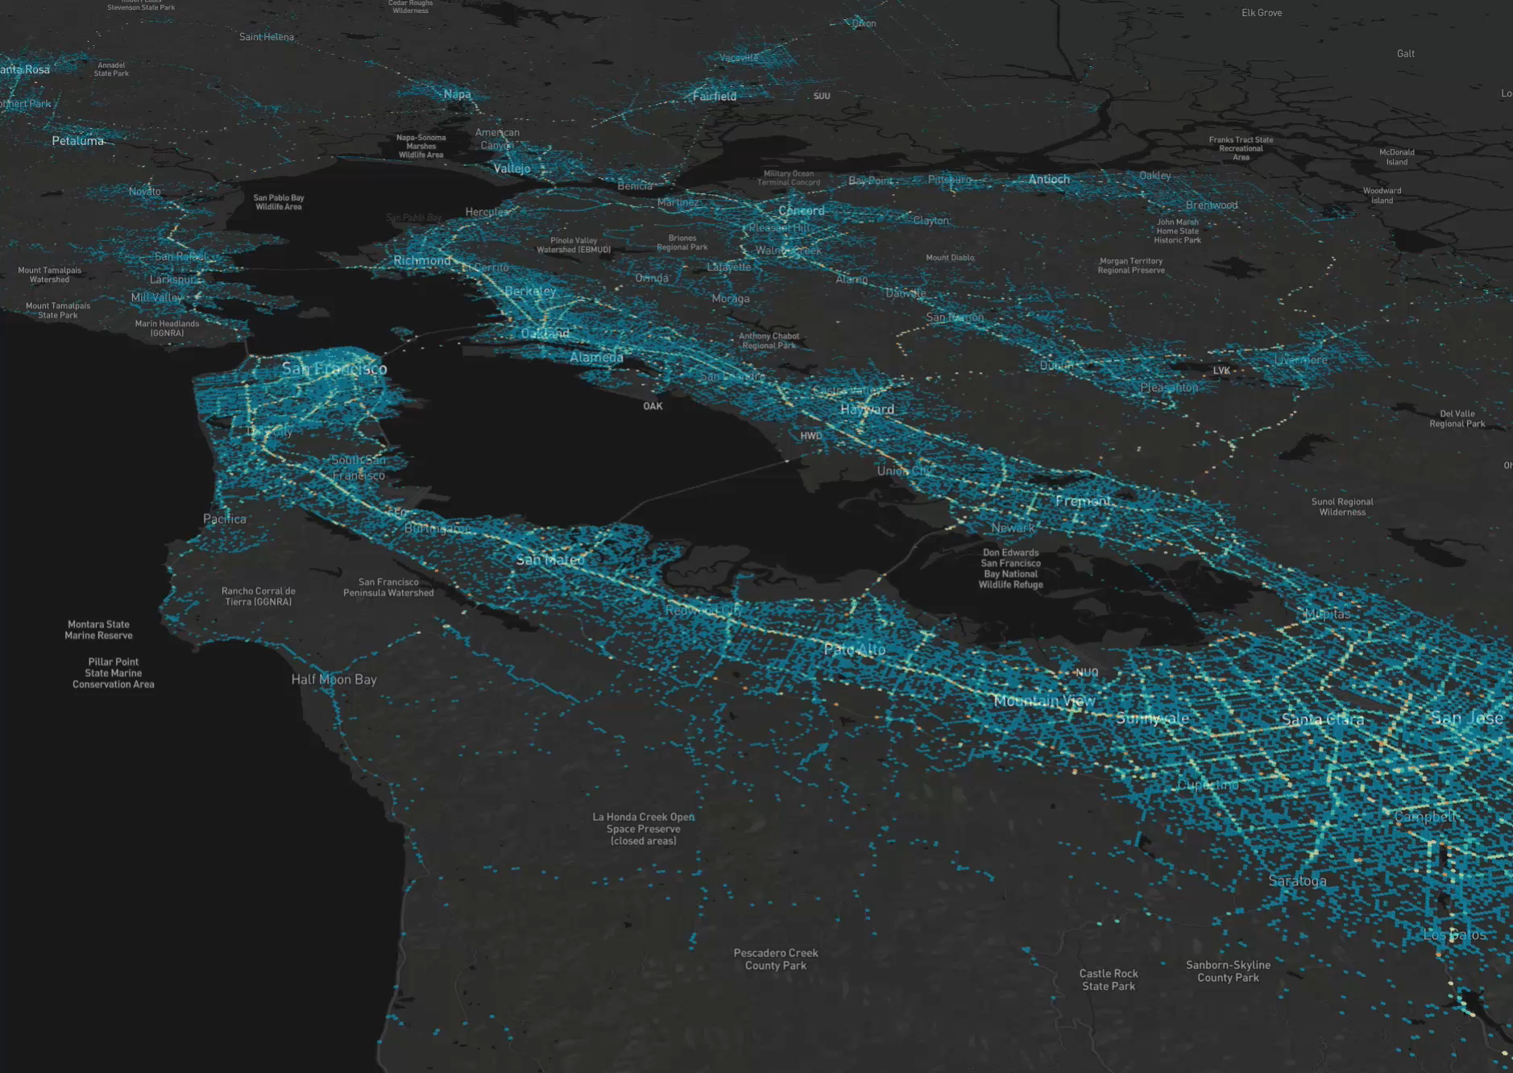
Slicing SF Bay Daily Energy Consumption

Slide 18
Price Sensitivities – Ride Hail Price
Scenarios:
Low -25%
Base
High +25%

Slide 19
Price Sensitivities – Transit Price
Scenarios:
Low -50%
Base
High +50%

Slide 20
Deadheading vs Price of Ride Hail

Slide 21
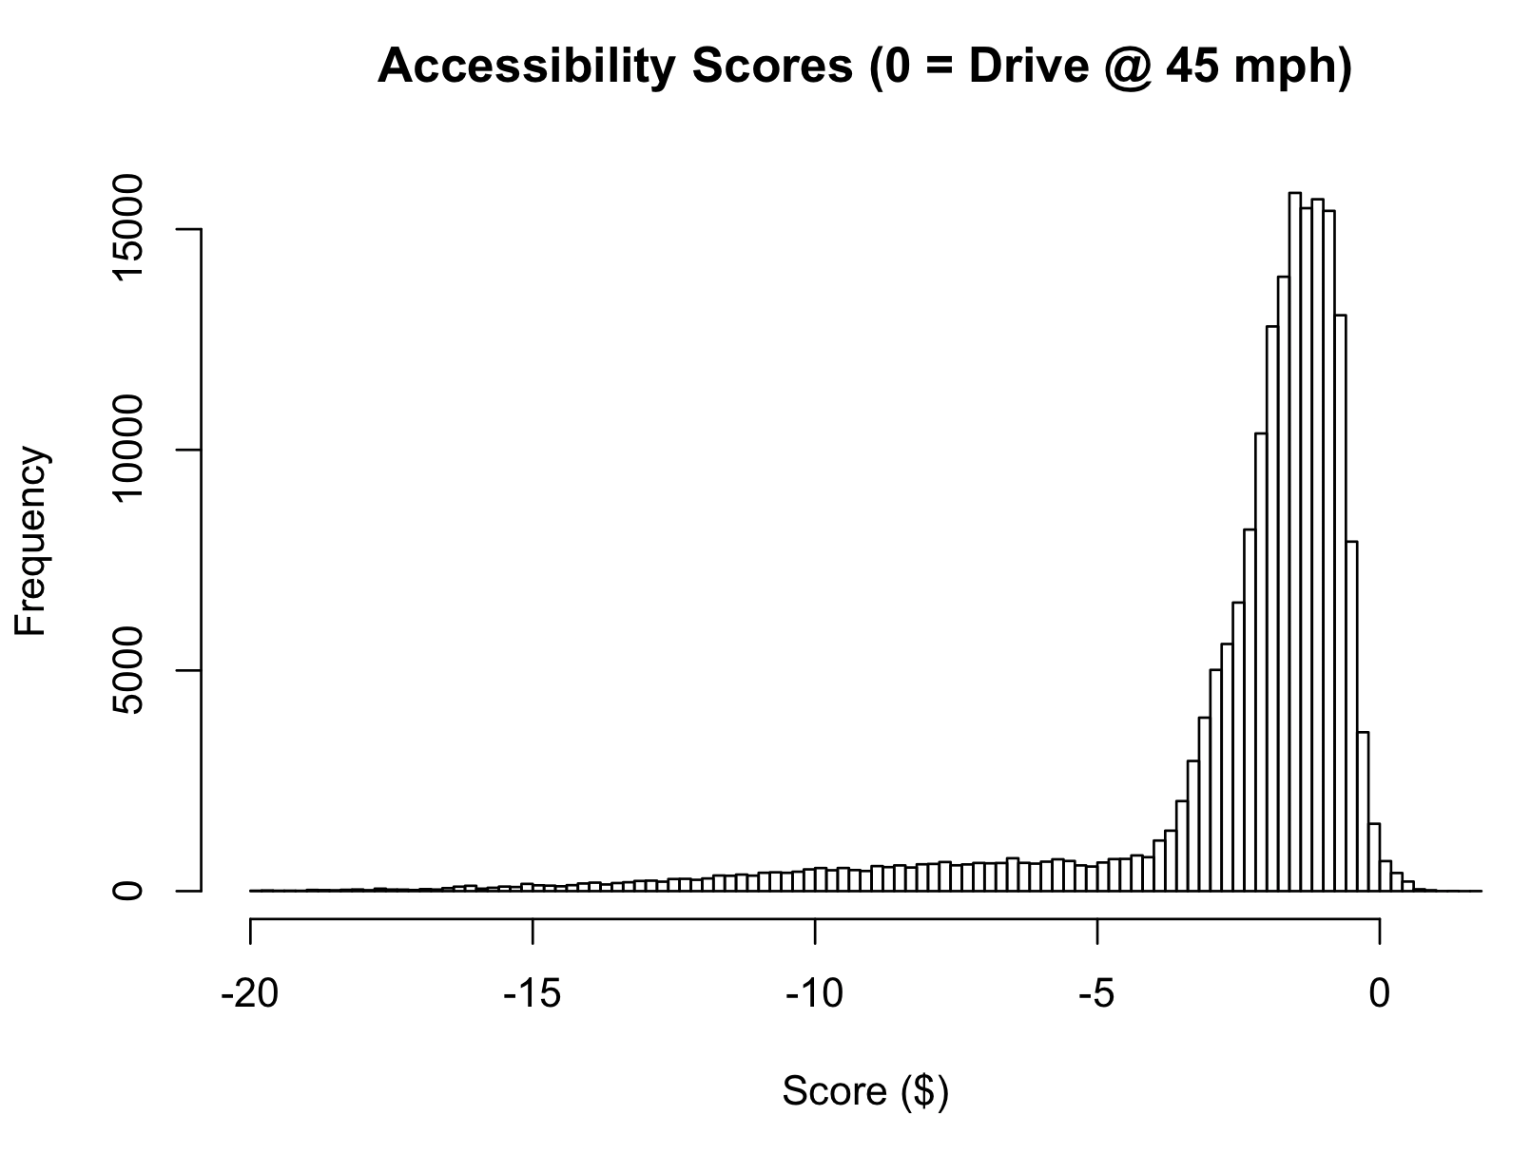
Accessibility Measure
Disutility of your choice set minus the disutility of a set that includes only driving at a constant speed of 45mph.
E.g. a choice set of walking-only that takes one hour longer than driving at 45mph with $10/hr value of time, would score -10.
Because accessibility is influenced both by cost and time, decreasing ride hailing price increases system accessibility

Slide 22
Impact of Surge Pricing
Using multinomial logit choice model
Surge pricing reduces TNC share by 2 percentage points
Of those no longer using TNC: 80% shift to Transit, 15% to walking, 5% to car
Surge pricing decrease energy consumption by 2%

Slide 23
Ride Hail and Transit Capacities
# Ride Hail Agents
Transit Seating Capacity
Scenarios:
Low -66%
Base
High +66%
Notes:
Make scenarios more explicit and hightly change in energy consumption +/- XX%

Slide 24
Impact of Value of Time
Using multinomial logit choice model
Large change in split driven by VOT changes
Argues for VOT heterogeneity
Scenarios:
Low $8.5/hr
Base $16.9/hr
High $25.4/hr

Slide 25
QUESTIONS?

